Slide 1
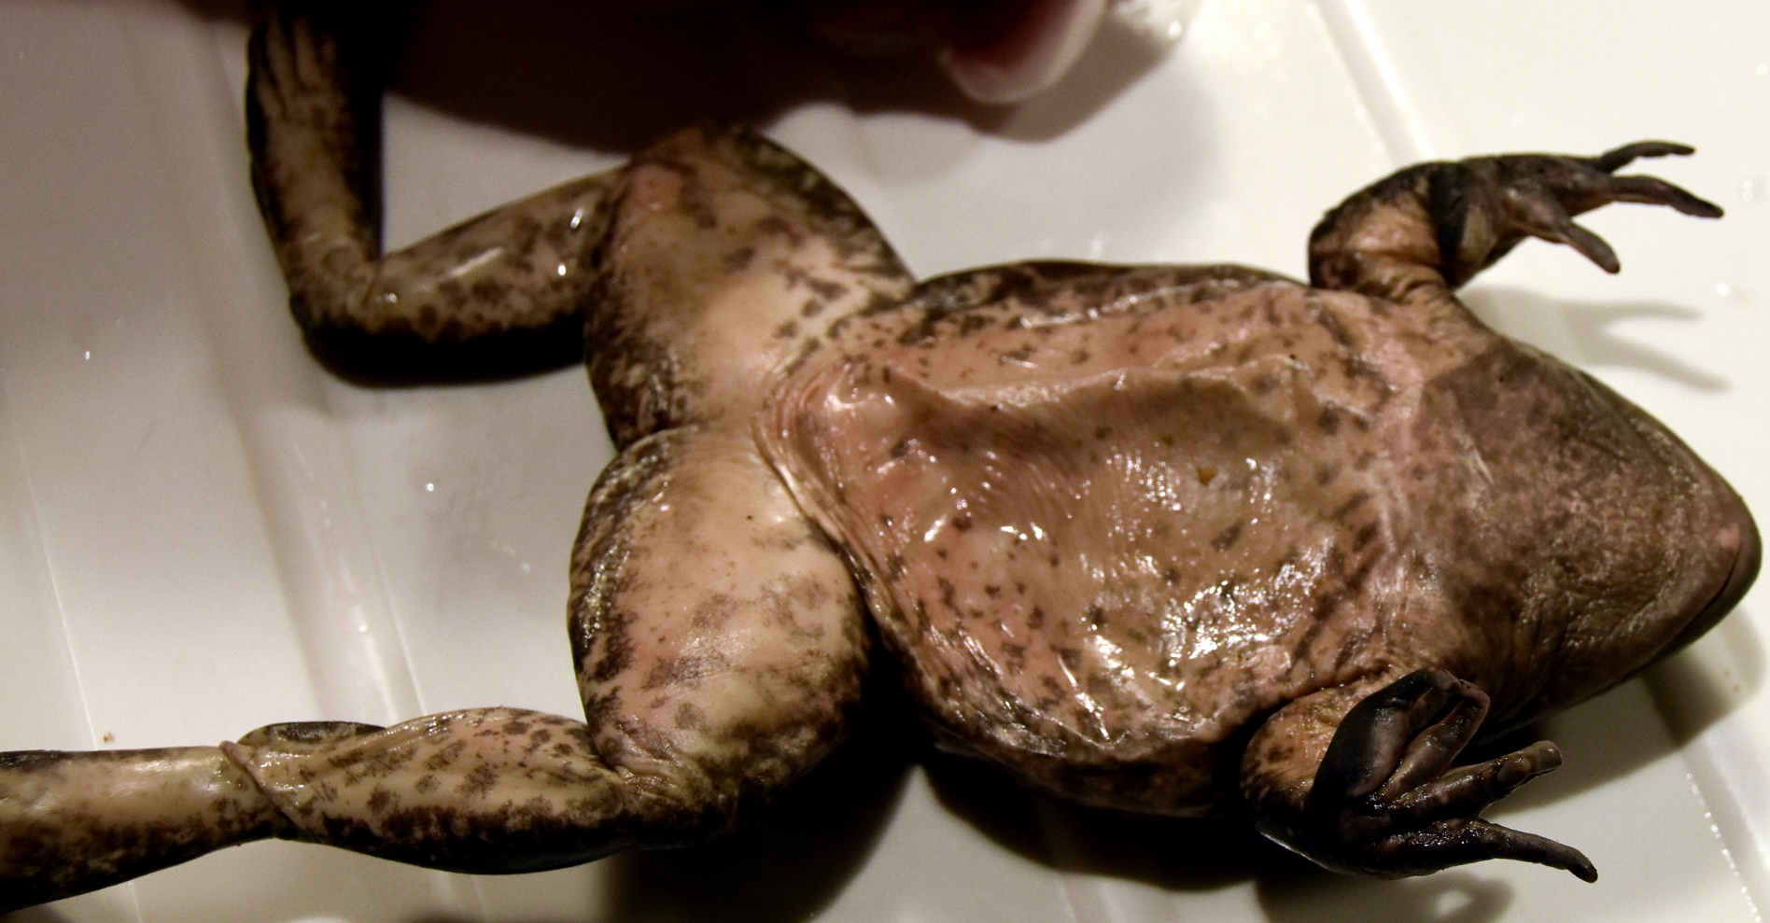
Interior of the Frog
Always cut away
from yourself
2
4
3
5
1
Exposing the coelom (body cavity) - You will make an incision at the midline of the frog near the rear legs. Place the scissors in the incision and press upward with lower part of the scissors against the skin to prevent cutting too deep. Make the 5 cuts shown above; repeat for muscle layer. Advance the slide to view cuts shown above and to view an accompanying video.
Click

Slide 2
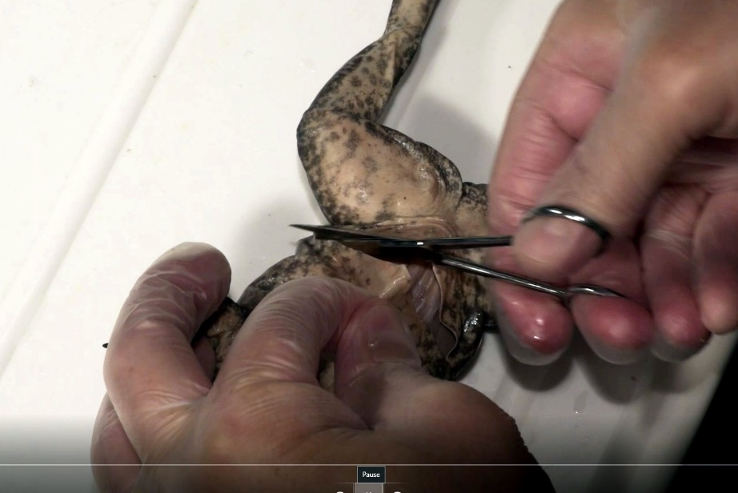
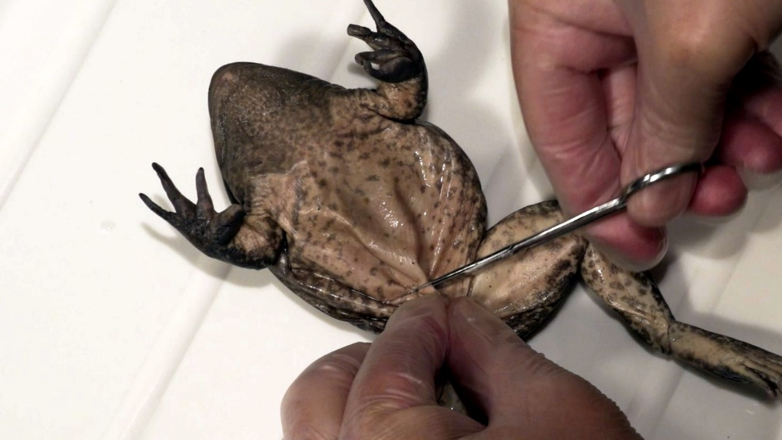
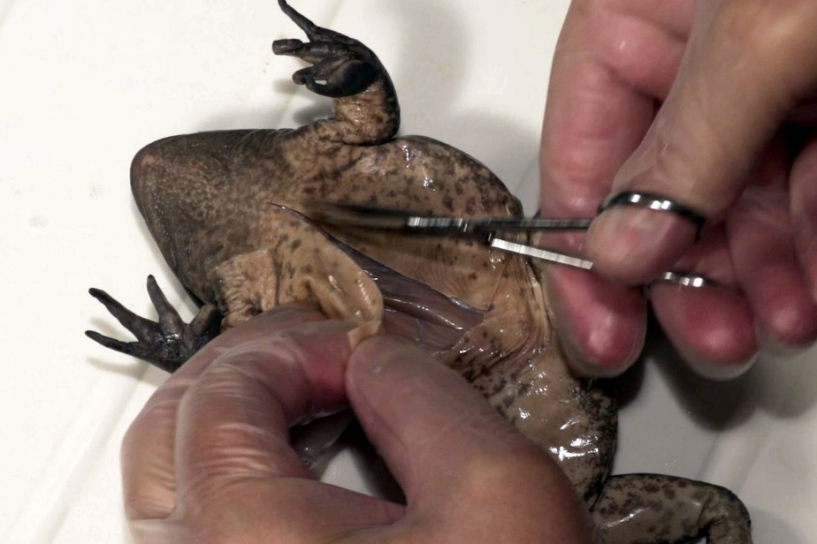
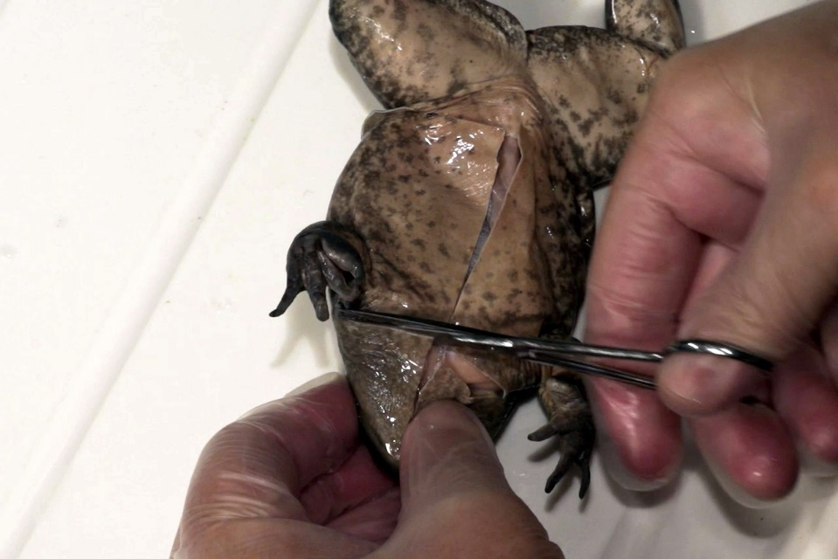
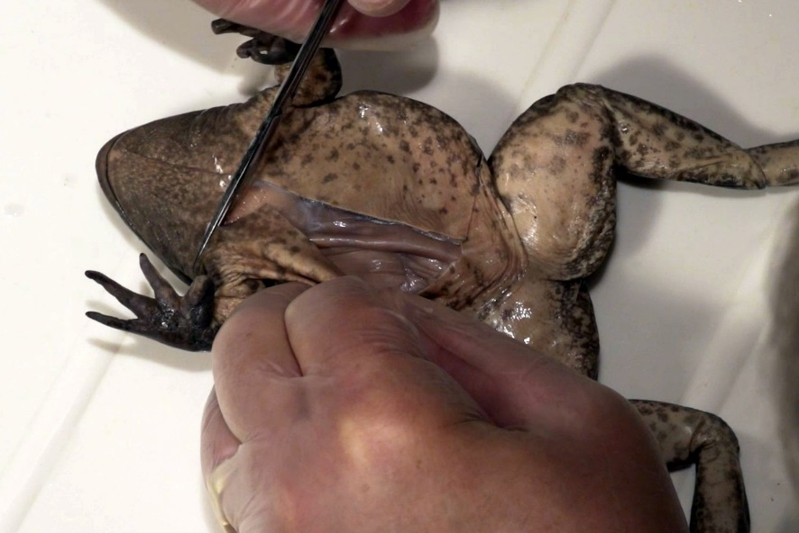
Same Cuts for the Muscles
Always cut away
from yourself
Interior of the Frog
1.
Skin Cuts
2.
3.
5.
4.
Click

Slide 3
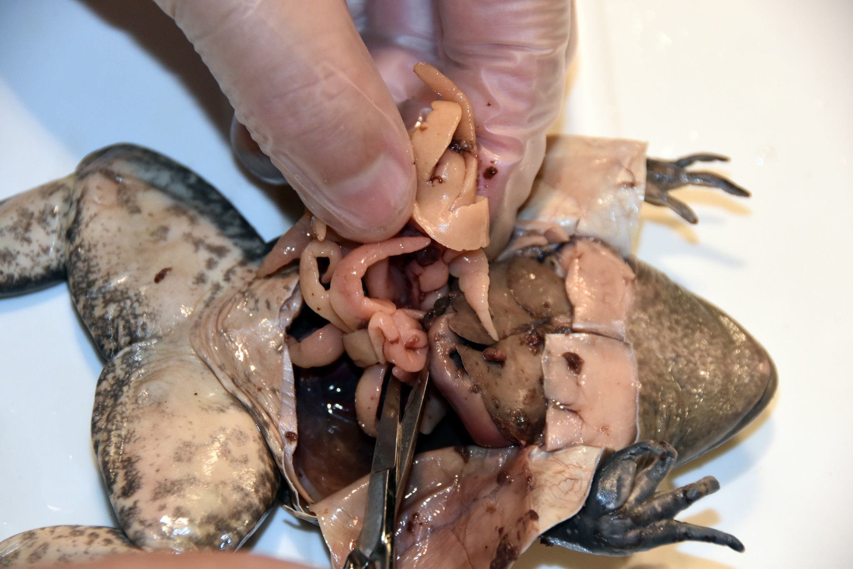
Interior of the Frog
Structure identification: Your specimen is unique. Many of the structures will not look exactly like the photos or drawings in your book. The following slides will identify structures using multiple views and specimens. We will identify structures in both male and female frogs.
Click

Slide 4
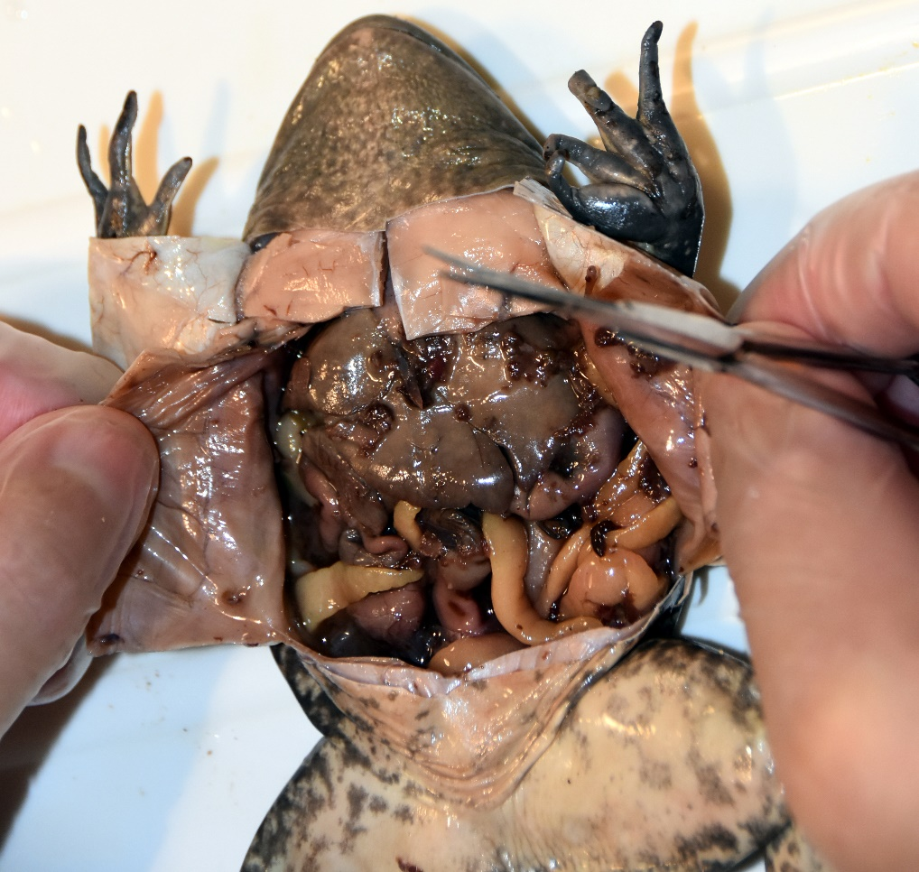
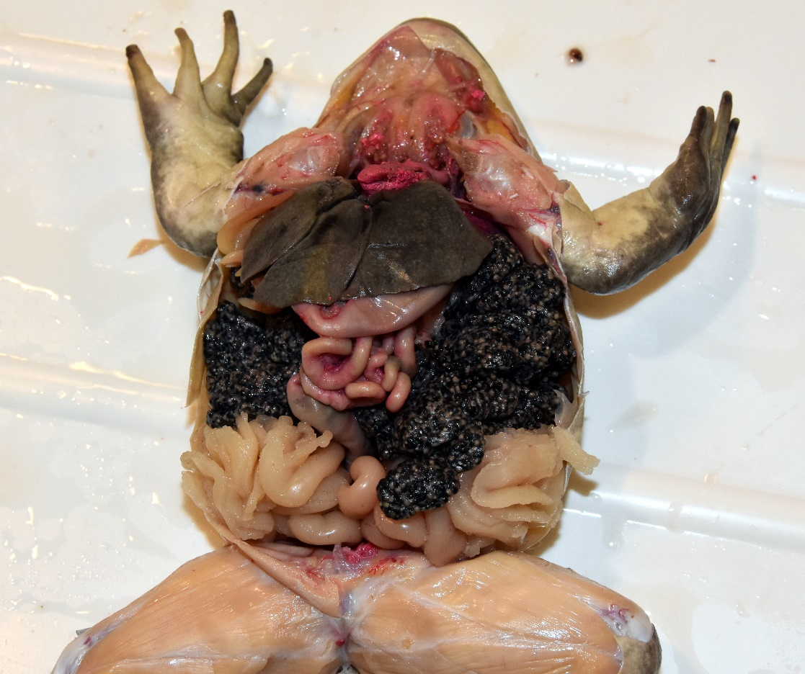
Interior of the Frog
Male
Female
Ovaries
Fat bodies
Oviducts
The photos above show two very different looking specimens. The frog on the right is a mature female (with red dye exposing the arteries); the frog on the left is a male. A mature female is easy to identify because of the large paired ovaries and extensive oviducts. Also note the difference between the oviducts and fat bodies. Fat bodies are fingerlike and found in both male and female frogs; oviducts are long tube-like structures.
Click

Slide 5
Interior of the Frog
Male
Female
Ovaries
Liver
Fat bodies
Oviducts
Oviducts – Eggs released by the ovaries enter the paired oviducts; extensive, tube-like, coiled structures in which the eggs mature; produce jelly-like material that surrounds the eggs; eggs released to environment by way of the uteri (paired uterus), cloaca
Liver – Large organ (3 main lobes) at the anterior end of the body cavity; the liver has many functions including detoxifying blood, storing of fats for energy, and the production of bile for fat digestion in the small intestine
Ovaries (female gonads) – Paired egg producing reproductive organs; grainy appearance (due to rounded follicles and eggs); larger during mating season; external fertilization – releases many eggs into water and then fertilized by sperm of male frog; some frogs will show parental care, like guarding the fertilized eggs
Fat bodies – Paired, fingerlike, fat tissue used for energy storage; attached to area above the kidneys, larger if specimen is in good health; energy for hibernation and reproduction
Click

Slide 6

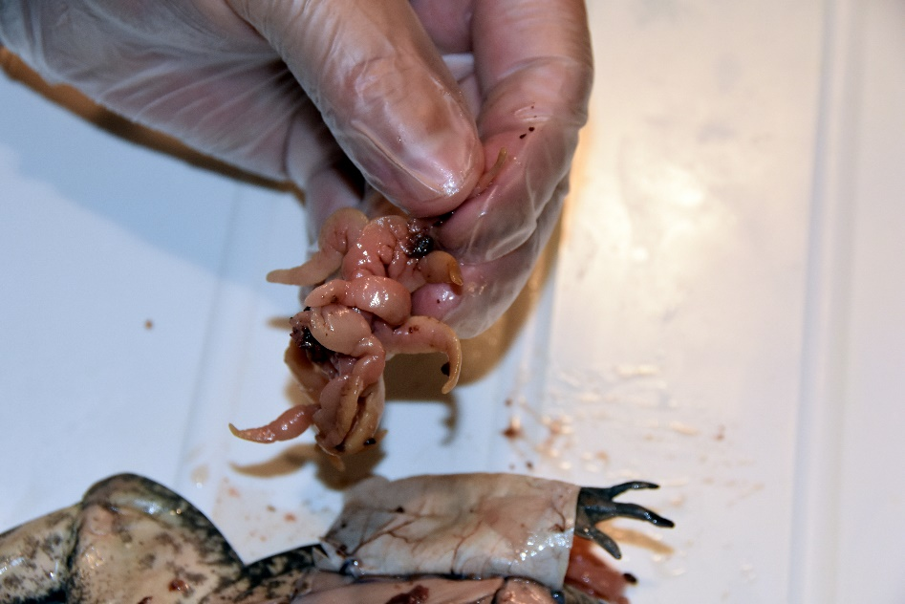
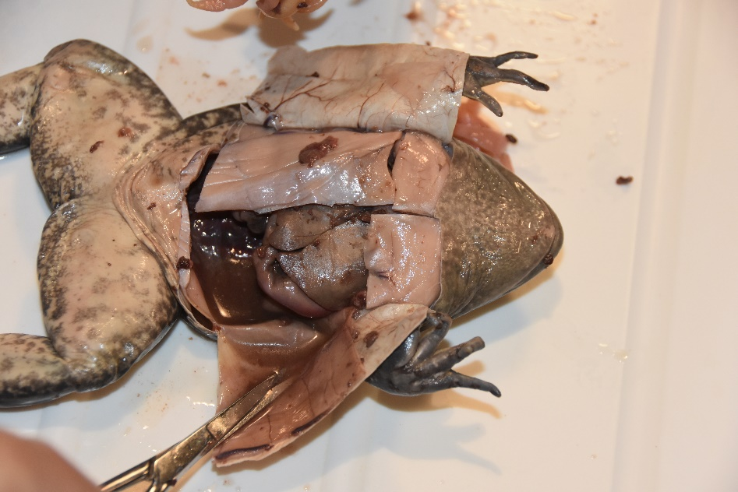
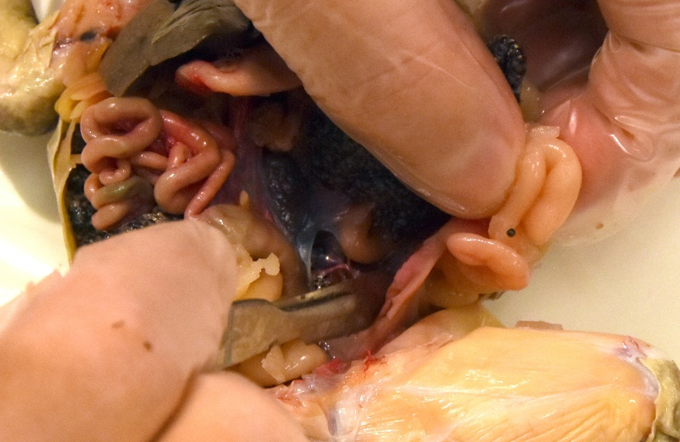
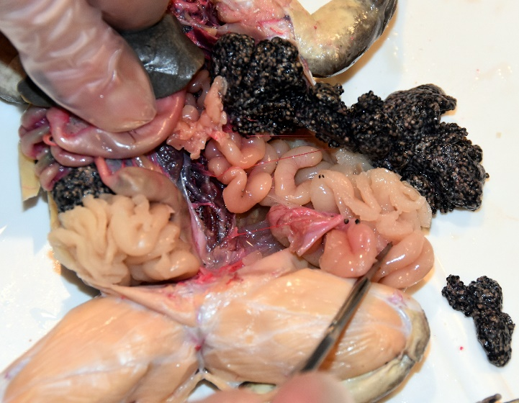
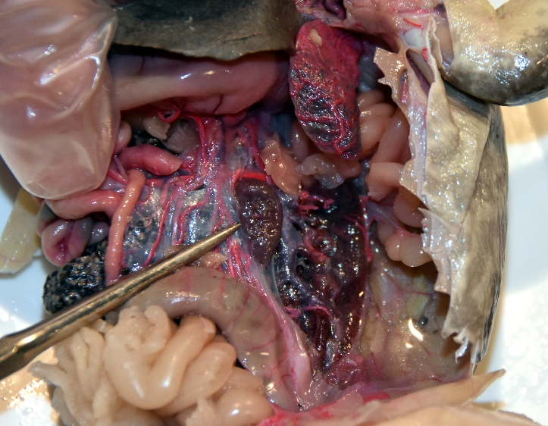
Interior of the Frog
Remove the following structures from at least one side of the frog.
Male – Remove fat bodies to identify additional structures
Female - Remove fat bodies, ovaries, and oviducts
Click

Slide 7
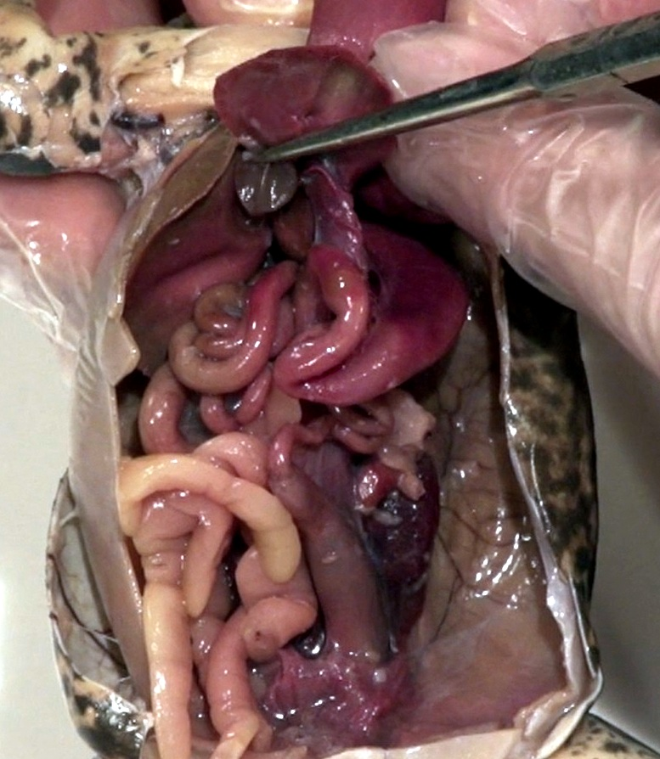
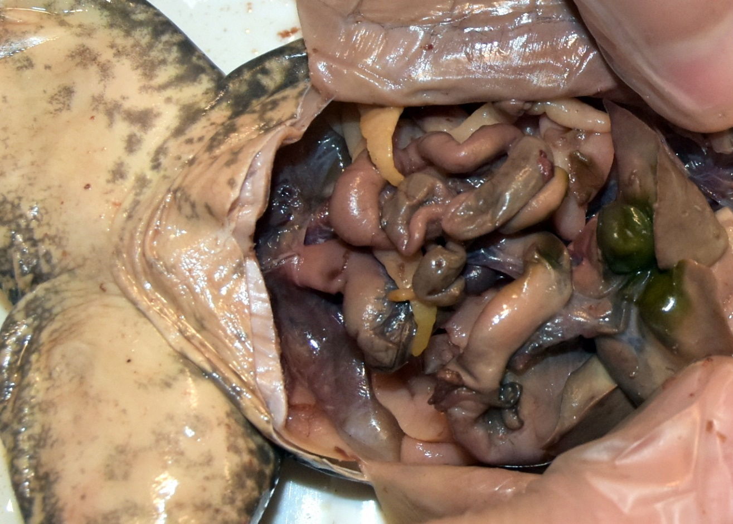
Interior of the Frog
Gallbladder – Green in color, found within the lobes of the liver (liver lifted in photo); stores bile produced by liver for fat digestion; enters small intestine
Note: Not every specimen will have a green gallbladder like the first specimen shown
Click

Slide 8
Interior of the Frog
Liver lifted
Stomach – Large j-shaped structure; food storage and digestion; complete digestive system
Gallbladder
Small intestine – Long tube-like structure (increased surface area); digestion and nutrient absorption
Large intestine (colon) - Water absorption; forms feces, excreted through cloaca
Fat bodies
Urinary bladder – Thin walled; urine storage
Click

Slide 9
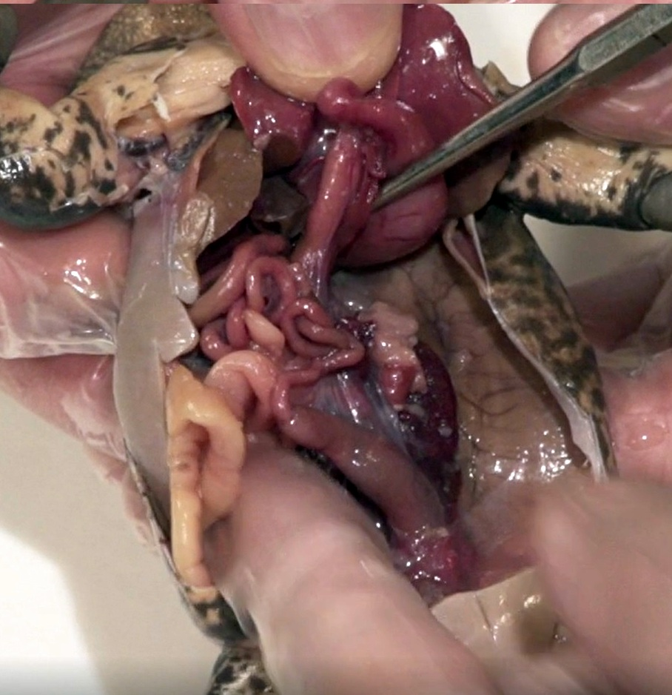
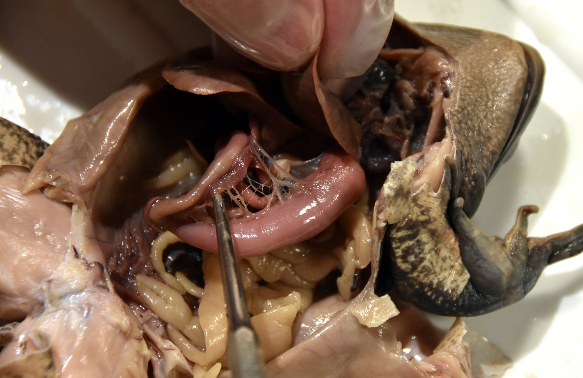
Interior of the Frog
Liver lifted
Stomach
Small intestine
Close-up of pancreas
(lighter specimen)
Pancreas – Located at the start of the small intestine; enzyme producing structure for digestion (pancreatic juices); hormone production, like insulin used for blood sugar regulation
Small intestine
Stomach
Fat bodies
Fat bodies
Large intestine
Click

Slide 10
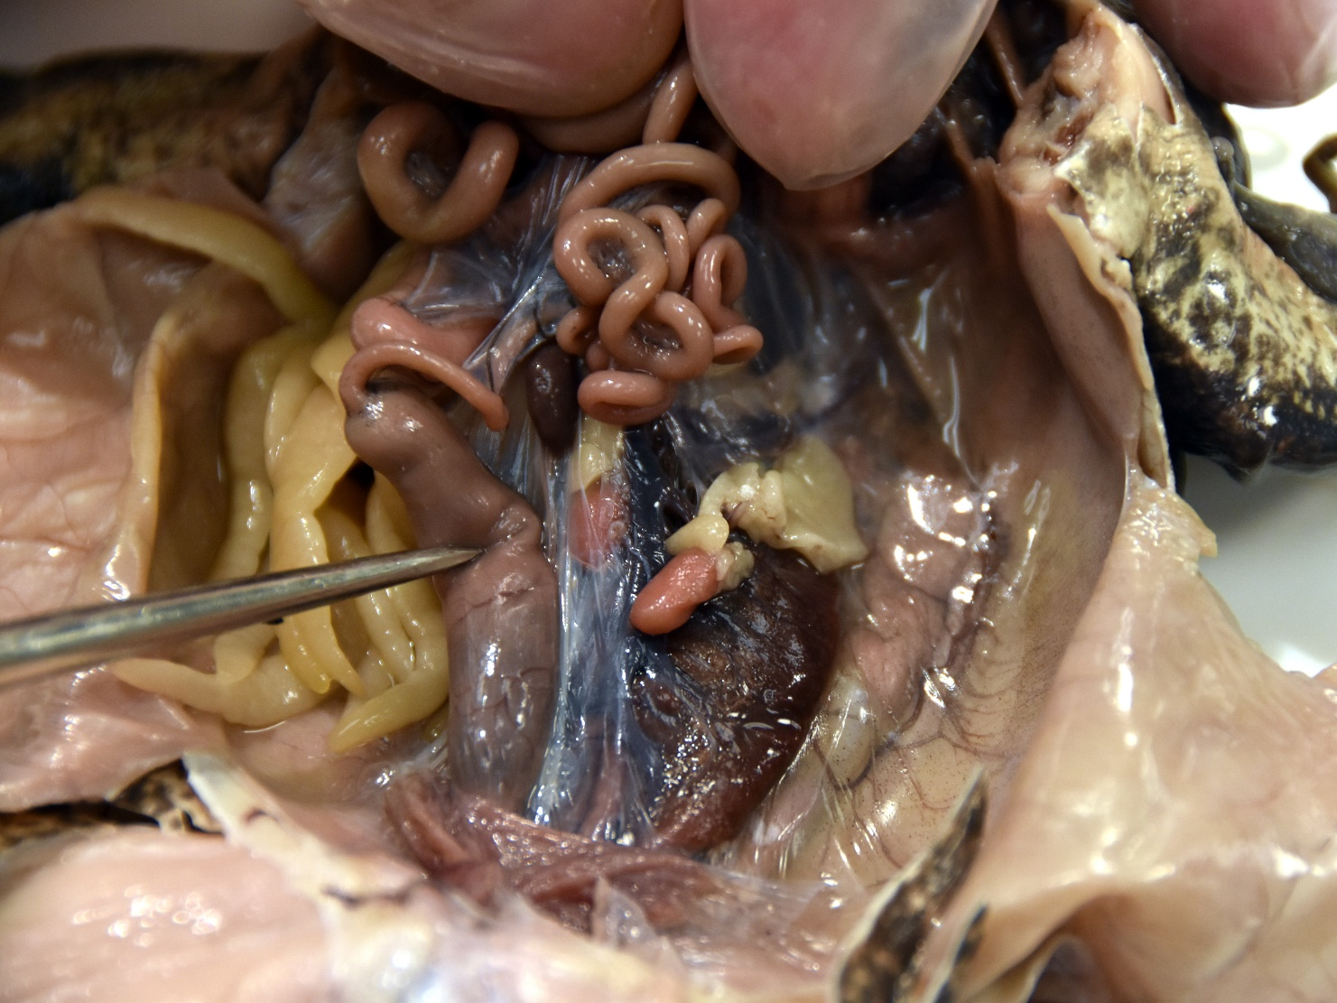
Interior of the Frog
Liver and stomach pulled back
Spleen – Immune (white blood cell production); filters and stores blood; found in mesentery; dark here, many times fleshy color
Small intestines
Fat bodies
Testes - Paired male gonads (testis - singular) located at the cranial end of the kidneys; produce sperm (larger in mating male)
Large intestine
Mesentery – Connective tissue; houses lymphatic tissue and blood vessels
Click

Slide 11
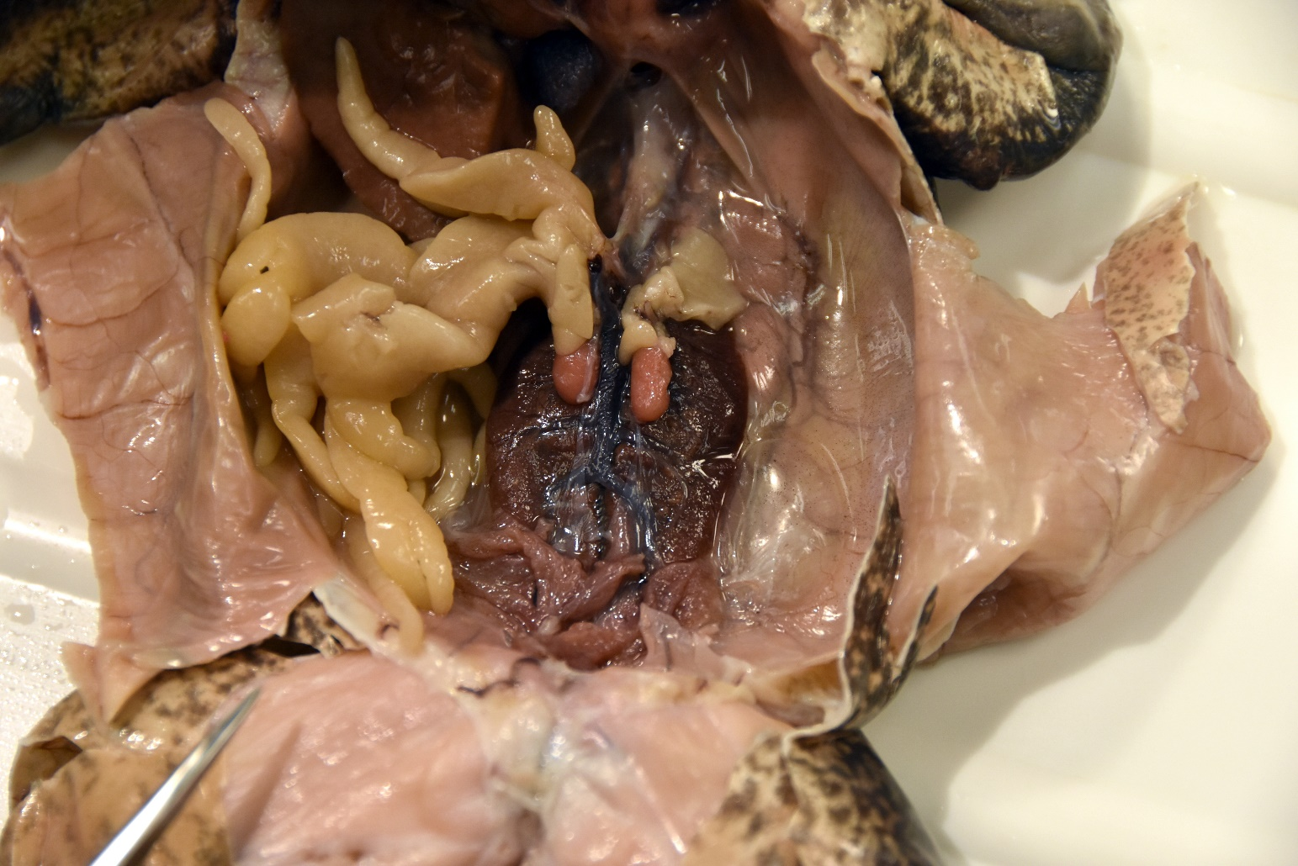
Interior of the Frog
Mesentery and Digestive System Removed (Male Shown)
Testes
Fat bodies
Kidneys - Excrete waste from the blood, produce urine; large, paired, dark organs found against the dorsal body wall
Urinary bladder
Click

Slide 12
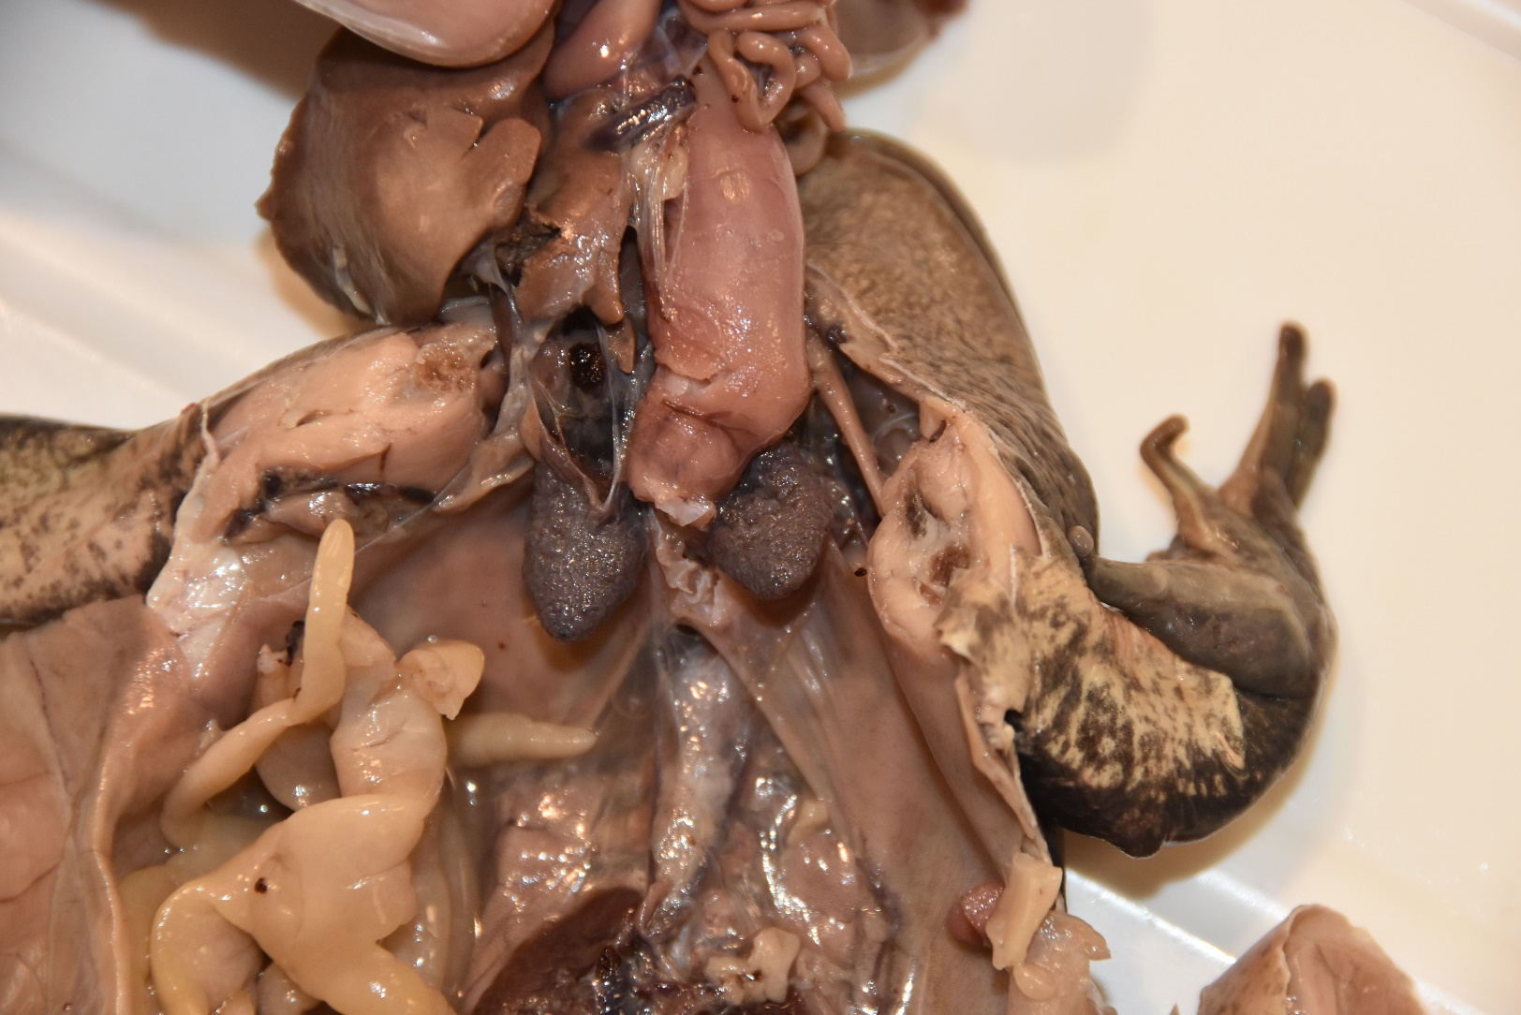
Interior of the Frog
Mesentery, Digestive System and Liver Moved Upward
Lungs (paired) – Deflated; not as complex as the human lung, have some compartmentalization but no alveoli; gas exchange for respiration, also gas exchange through skin/mouth
Click

Slide 13
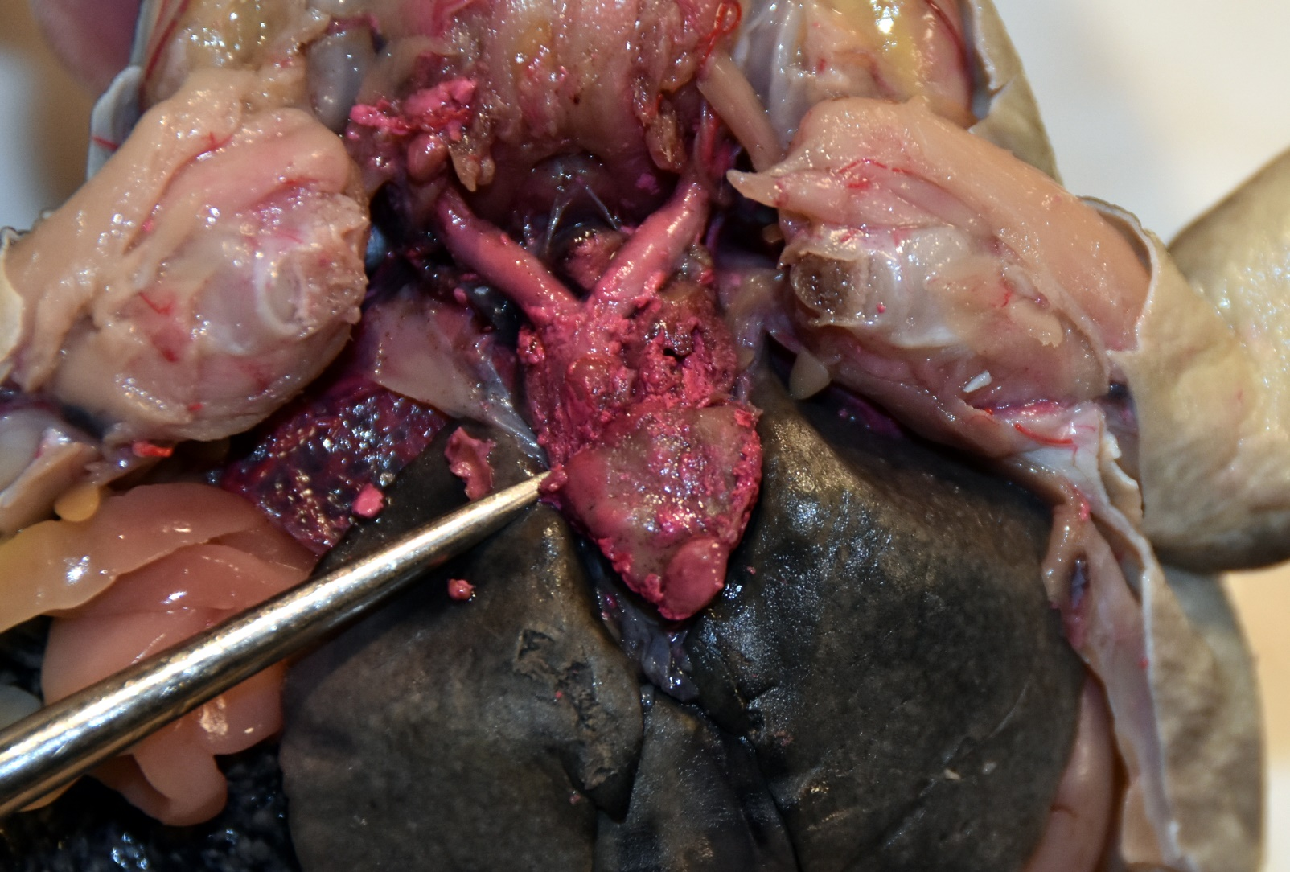
Interior of the Frog
Conus Arteriosus
No Dye
Left Atria
Conus Arteriosus
Left Atrium
Right Atrium
Ventricle
Right Atrium
Liver
Ventricle
Heart (dyed) – Closed system; deoxygenated blood (from the body) and oxygenated blood (from the skin) enters the right atrium; oxygenated blood (from the lungs) enters the left atrium. Blood is then pumped from both atria to the ventricle. The ventricle then pumps the blood through the conus arteriosus. Oxygen-poor blood is pushed to the lungs; oxygen-rich blood is shunted to the rest of the body. The process then repeats.
Click

